Slide 1
Chat room
Kandahar university
Faculty of computer science
Group members
Ehsanullah
Faiz ahmad
Samiullah
Mohammad naeem
Khail mohammad
Teacher :Mohammad yasin zahin

Slide 2
Roadmap
What is Relationship between network and chatroom?
What is socket?
How communicate client and server on order to send messages?
How implemented chatroom in different technologies?

Slide 3
Chatroom and network relation;
Chat rooms are web sites or programs that allow to people to send text message to one another in real time ,
the chat room works as a virtual room where group of people of send messages;
What is socket?
A network socket is a software structure within a network node of a computer network that serves as end point for sending and receiving data across the network,
Socket structure is defined by application programming and network architecture;

Slide 4
client and server communication
Client and servers communicate by exchanging individual messages. The messages sent by the client.
usually a web browser, are called requests and the messages sent by the server as an answer are called responses.

Slide 5
Implementation of chat room
client class package chatroom_secure; import java.io.DataInputStream; import java.io.DataOutputStream; import java.io.IOException; import java.net.InetAddress; import java.net.Socket; public class Chat_Client
extends javax.swing.JFrame { static Socket s; static DataInputStream din; static DataOutputStream dout; public Chat_Client() { initComponents(); } private void msg_sendActionPerformed(java.awt.event.ActionEvent evt) { try { String msgout =""; msgout = msg_text.getText().trim(); msg_area.setText(msg_area.getText().trim()+"\nClient: "+msgout); dout.writeUTF(msgout); }catch(Exception e){ } } public static void main(String args[]) throws IOException { InetAddress ca = InetAddress.getLocalHost(); String str = ca.getHostAddress(); s = new Socket(str,1201);

Slide 6
Implementation of chat room
Server class package chatroom_secure; import java.io.DataInputStream; import
java.io.DataOutputStream; import java.io.IOException; import static java.lang.System.in; import static java.lang.System.out; import
java.net.ServerSocket; import java.net.Socket; import java.util.HashSet; import java.util.Set; import java.util.Scanner; import java.util.ArrayList; import
java.util.concurrent.ExecutorService; import java.util.concurrent.Executors; import java.net.InetAddress; import java.net.UnknownHostException; public class
Chat_Server extends javax.swing.JFrame { private static final Set<String> names =
new HashSet<>();

Slide 7
Tcp socket API
Server socket
Client socket
Client ip:192.20.10.0
Port:2300
Server ip:192.40.10.3
Sever ip:192.34.4.0
Port:1400
Port:1200
Client ip:192.34.6.8
Port:1400

Slide 8
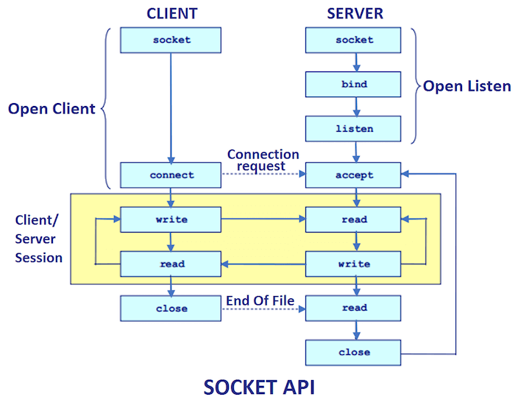
Client and server request via socket

Slide 9
Results
In this presentation we have learnt
Chat room is web sites or program to send messages
Socket serves as end point for sending and receiving message
Sending messages between client and server
Implementation of chat room in java technology

Slide 10
References
Java point.com
Google

